Slide 1


NANO PROCESSOR
VIVA PRESENTATION - GROUP 45
Course: CS1050 – Computer Organization and Digital Design

Slide 2

INTRODUCTION
Objective
To design a 4-bit nano-processor capable of executing a simple instruction set using VHDL and simulate its functionality
Why?
Helps understand CPU architecture and instruction execution
Bridges theory with hardware-level digital design
Uses practical skills: VHDL, simulation tools, schematics
Software - Vivado (2018 version)
Language - VHDL
Tested on - Basys3 Board

Slide 3
INTRODUCTION
Key Features
To design a 4-bit nano-processor capable of executing a simple instruction set using VHDL and simulate its functionality.
Includes a custom instruction decoder and program ROM.
Output every calculation through outputs mapped to LEDs of the BASYS 3 FPGA board.

Slide 4
BASIC PROCESSOR
INSTRUCTION SET
MOVI Ra,d - Move immediate 4-bit value d to register Ra
ADD Ra,Rb - Add values in register Ra & Rb and store the result in Ra
NEG R - 2’s complement of the binary value in register R.
JZR R,d - Jump to line d(of instructions) if the value in register R is 0.

Slide 5
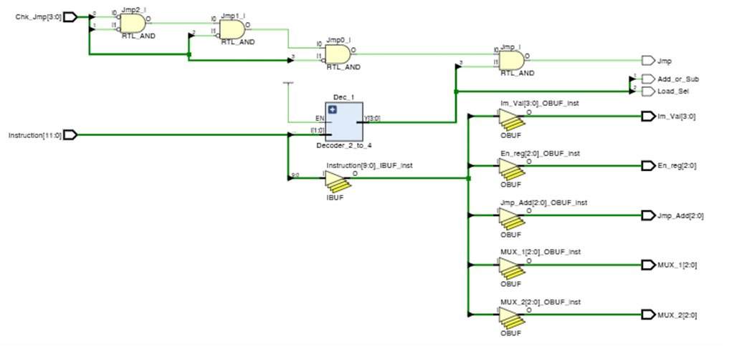
INSTRUCTION DECODER
Key Features
Decodes the 12 bit instructions as inputs/commands for the different components connected.
Checks the jump function and passes it onto the 3bit multiplexer.
Sends the instruction to the add/sub unit to define it's operation.

Slide 6
INSTRUCTION DECODER
10 | MOVI R,d | 1 0 R R R 0 0 0 d d d d (Store the values represented in d d d d in the register shown in R R R)
00 | ADD Ra, Rb | 0 0 Ra Ra Ra Rb Rb Rb 0 0 0 0 (Add the values stored in (Ra Ra Ra) and (Rb Rb Rb) and store it back to register Ra)
01 | NEG R | 0 1 R R R 0 0 0 0 0 0 0 (Subtract the value stored in register (R R R) from 0 to make the value negative, and store it back in (R R R)
11 | JZR R,d | 1 1 R R R 0 0 0 0 d d d (If (R R R) = 0, program counter should call ROM (d d d), else program counter should increase it’s value by 1)

Slide 7
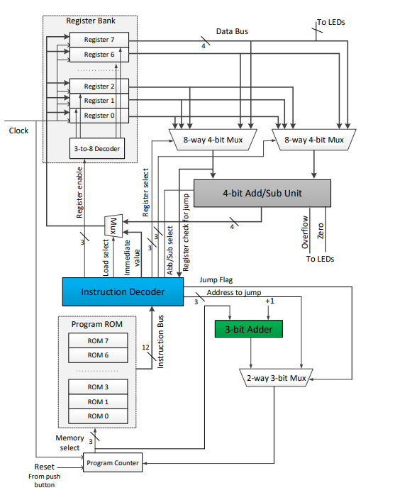
HIGH LEVEL
DESIGN

Slide 8
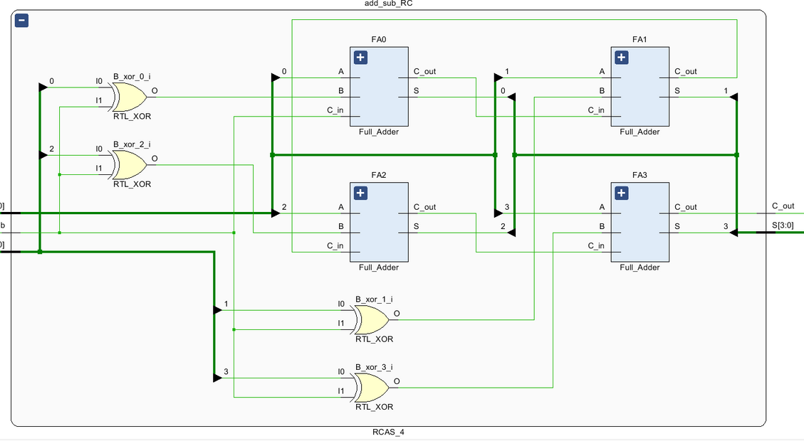
4 BIT ADDER/SUBSTRACTOR
Key Features
Made of 4 full adders (which in turn are made of two half adders each)
It has a control line that determines whether the operation is addition or subtraction.
It has a 4-bit output line (S) that represents the result of the operation.
It has a carry-out line (C_out) that indicates whether the result of the operation has overflowed (i.e., exceeded 4 bits).

Slide 9
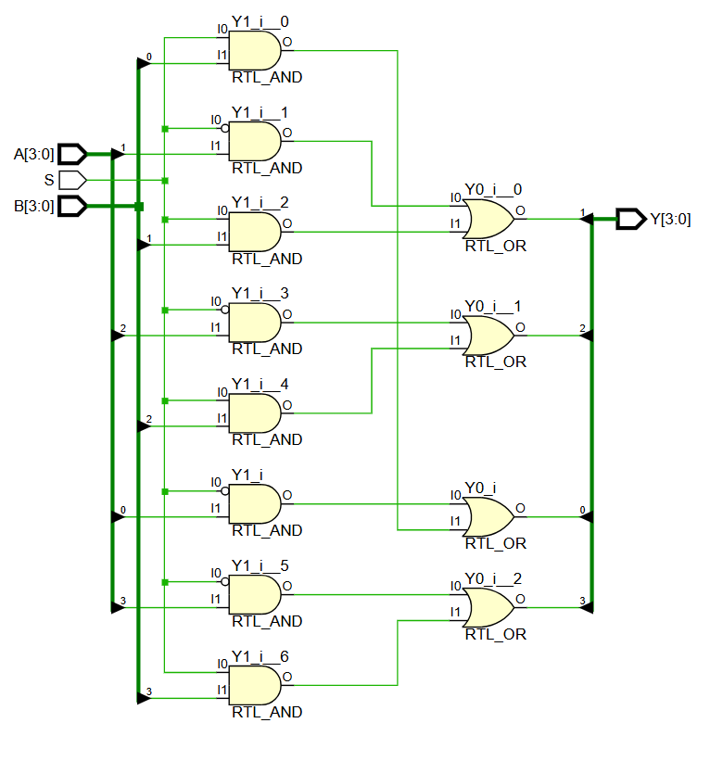
2 WAY 4 BIT MULTIPLEXER
Key Features
It has 2 input lines (I0 and I1) that select which of the two 4-bit input groups to pass through to the output.
It has 1 select line (S) that determines which of the two 4-bit input groups to select.
It has 4 output lines (O0, O1, O2, O3) that carry the selected 4-bit input.
Made of AND gates and OR gates

Slide 10
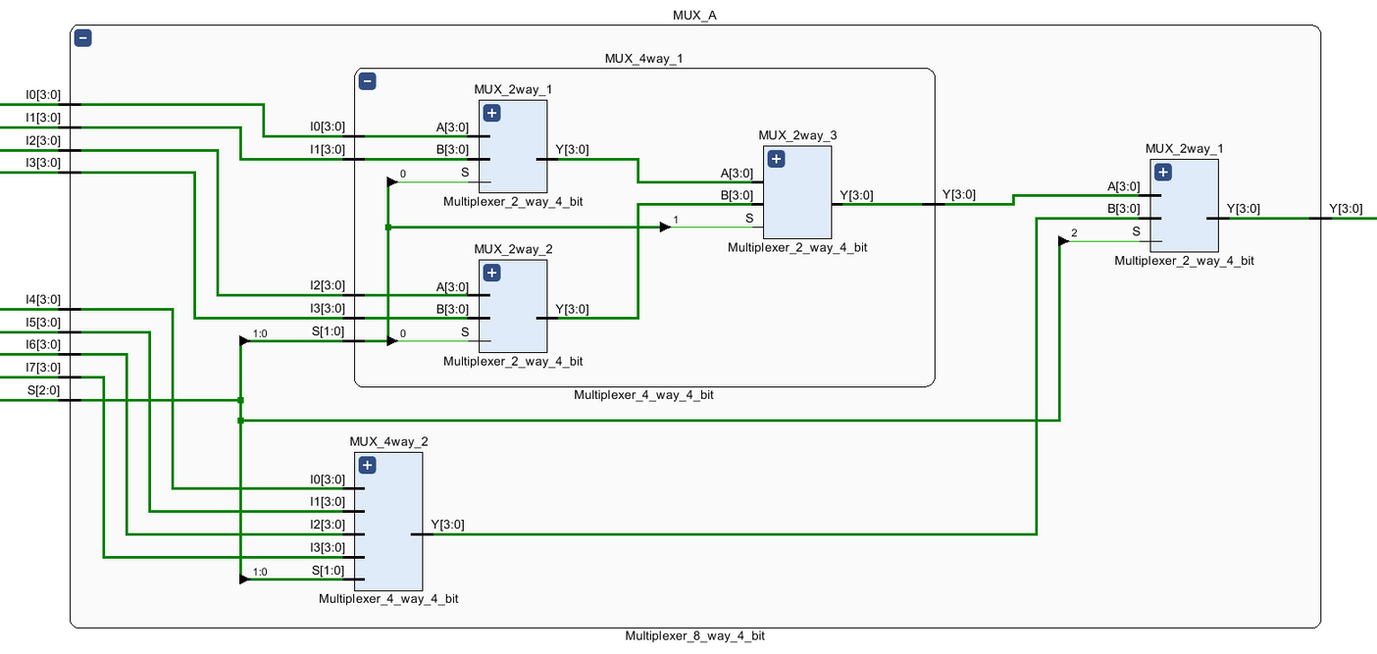
8 WAY 4 BIT MULTIPLEXER
Key Features
It has select lines that determine which of the 8 inputs to select, using a 3 bit binary number
t has 4 output lines (Y0, Y1, Y2, Y3) that carry the selected 4-bit input.
Built using multiple 2 Way 4 Bit MUXs

Slide 11
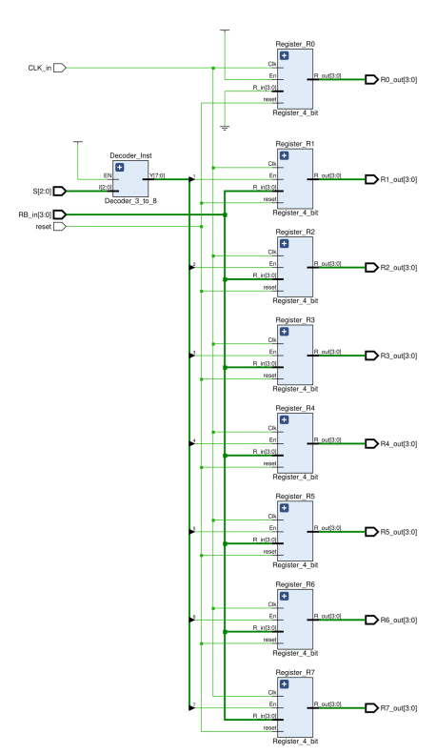
REGISTER BANK
Introduction
Small, fast memory unit implement by severel registers.
Eight 4 - bit registers, labeled R0 through R7.
Used to store intermediate values during program execution.
One special register : R0, always hold value 0000.

Slide 12
REGISTER BANK
Internal Design
The Register Bank uses a 3-to-8 decoder to select which register to write data to.
And each register is built using a component called Register_4_bit.
Clock tick and enable is high, correspondig register stores the 4 - bit value

Slide 13
REGISTER BANK
Simulation & Output
In our simulation:
We reset all registers to zero.
Then we wrote values like 1010 to R1, 1100 to R2, and 1111 to R7.
After each write operation, we checked the outputs to confirm the correct data was stored.

Slide 14
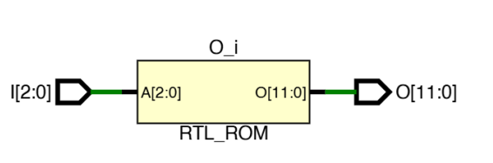
PROGRAM ROM
Introduction
Program ROM is where we store the machine instructions that the nano-processor will execute.
Each instruction is 12 bits long, stored 8 such instructions.
ROM is addressed using a 3-bit input, which usually comes from the program counter.
3 bit - OPCODE
3 - 5 bits - Register 1
6 - 11 bits - Immidiate val

Slide 15
PROGRAM ROM
VHDL Design
we implemented the ROM using an array of std_logic_vector.
Here’s a small example:
"100010000010", -- MOVI R1, 2
"101110000011", -- MOVI R7, 3
"100100000001", -- MOVI R2, 1
"010100000000", -- NEG R2
...
Where I is the 3-bit address input, and O is the 12-bit output instruction.

Slide 16
PROGRAM ROM
Simulation & Example
We simulated the ROM by feeding all 8 possible addresses from 000 to 111.
Example:
Address 000 returned 100010000010 – that’s MOVI R1, 2.
ROM is addressed using a 3-bit input, which usually comes from the program counter.

Slide 17
PROGRAM ROM
Conclusion
The Register Bank gives our nano-processor 8 storage locations for temporary data. It uses a decoder and clocked logic for controlled updates.
The Program ROM provides the instruction stream that drives the processor’s behavior. Each instruction is 12 bits and is fetched using a 3-bit address

Slide 18
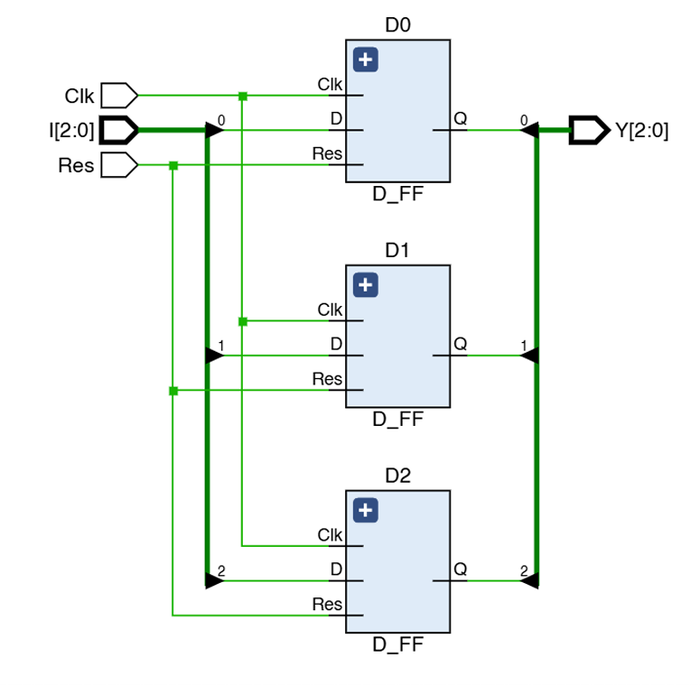
PROGRAM COUNTER
Introduction to the Program Counter
A 3-bit register that holds the address of the next instruction to execute.
Directs the processor to the correct instruction in Program ROM.
After each instruction, PC is typically incremented to point to the next instruction.
In case of jump instructions, PC can be overridden with a new address.

Slide 19
PROGRAM COUNTER
Internal Design and VHDL Code
Built using three D Flip-Flops, one for each bit of the counter.
Takes input 3 - bit input new instruction address.
Controlled by clock (Clk) and reset (Res) signals.
Output – Current address value (used as input to Program ROM).
ROLE OF PC IN NANO-PROCESSOR OPERATION
Why the Program Counter is Crucial ?
Without PC: processor would not know what to execute next.
Works closely with: Program ROM (instruction fetching),Instruction Decoder (execution logic).

Slide 20
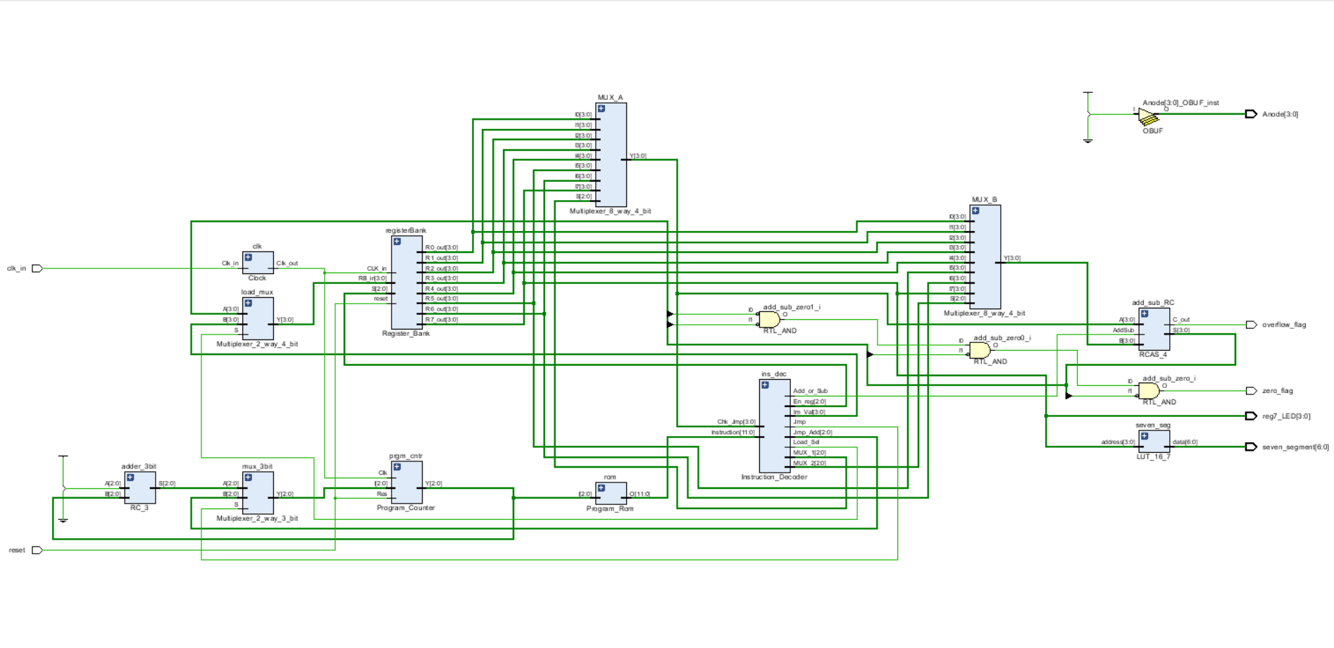
INTEGRATION

Slide 21
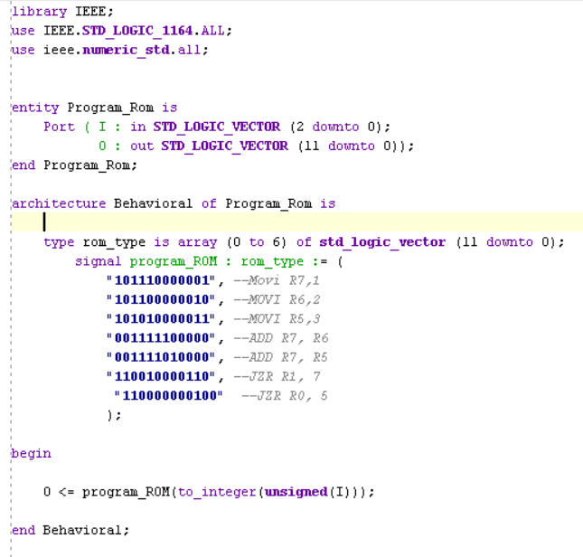
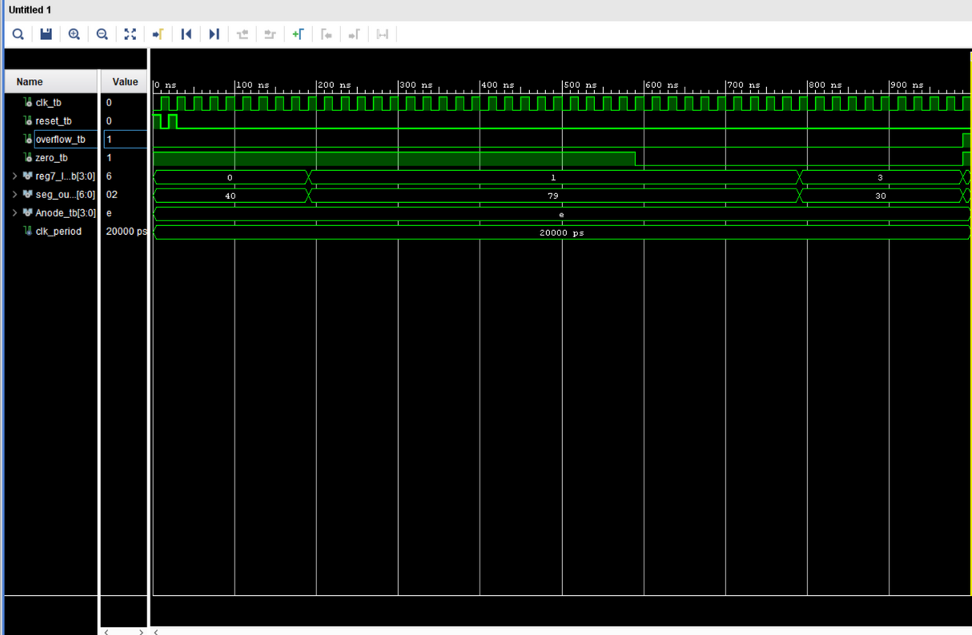
SIMULATION

Slide 22
IMPROVED
NANO PROCESSOR

Slide 23
INSTRUCTION DECODER
10 | - | 10 RRR 000 dddd Move the value dddd to register RRR
00 | 0000 - add | 00 RaRaRa RbRbRb 0000 Add values in Ra, Rb and store in Ra
00 | 0001 - subtract | 00 RaRaRa RbRbRb 0001 Subtract values in Ra, Rb and store in Ra
00 | 1000 - negate | 1 1 R R R 0 0 0 0 d d d (If (R R R) = 0, program counter should call ROM (d d d), else program counter should increase it’s value by 1)
11 | - | 00 RaRaRa 000 1000 Jump to the given instruction if check jump is = "0000"

Slide 24
INSTRUCTION DECODER
00 | 0010 - AND | 00 RaRaRa 000 1000 Negate the value in Ra
00 | 0011 - OR | 00 RaRaRa RbRbRb 0011 Bit operation OR to the values in Ra, Rb
00 | 0100 - XOR | 00 RaRaRa RbRbRb 0100 Bit operation XOR to the values in Ra, Rb
00 | 0101 - multiply | 00 RaRaRa RbRbRb 0101 Multiply Values in Ra, Rb and store in Ra
00 | 0111 - compare | 00 RaRaRa RbRbRb 0111 Compare the value in Ra to Rb and provide an out signal saying whether it is less than, greater than or equal.

Slide 25
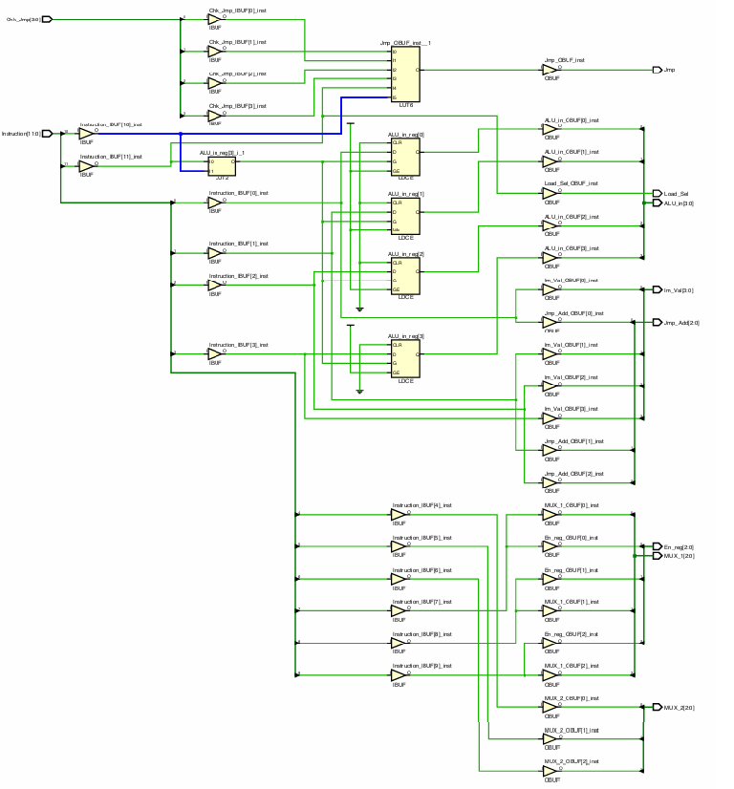
INSTRUCTION DECODER
Breaks the 12 bit instruction to various components, each giving a component an input/command.
The original instruction format was slightly changed in the improved nano processor.
Gives instructions to the ALU to define the component which is used in the current operation.

Slide 26
ALU
MUX A
MUX B
OPERATION
Adder/Subtractor
Multiplier
Bit Operators
Comparator
AND
OR
XOR
4 BIT OUTPUT

Slide 27
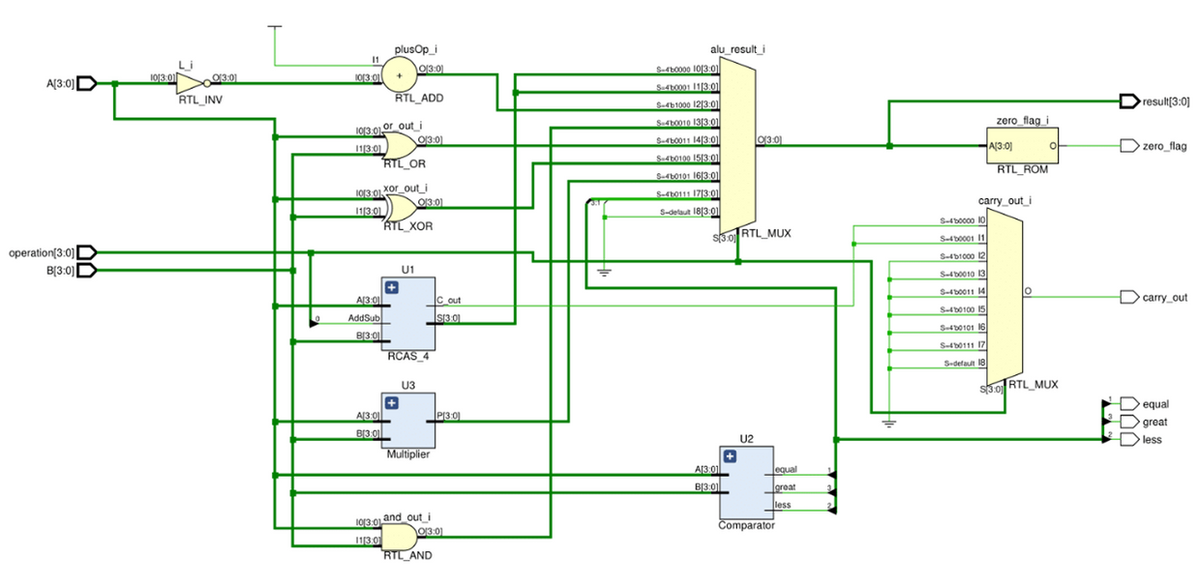
ALU
Has an extra input compared to the basic nano processor. This input decides which component to use for that instruction.
The ALU has 1, 4 bit out releasing the results of the operations, and 3 LED coming directly from the comparator.

Slide 28
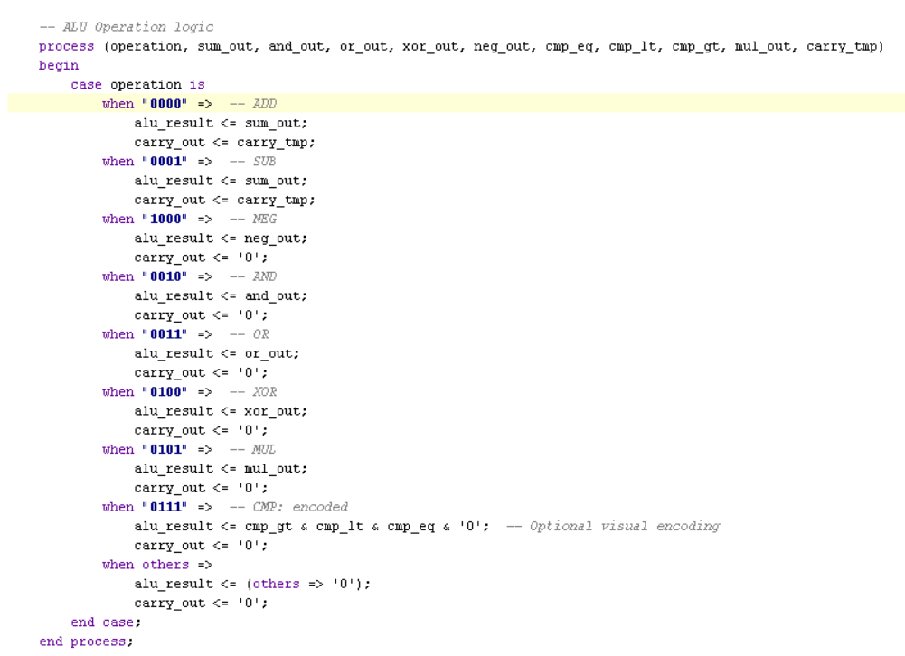
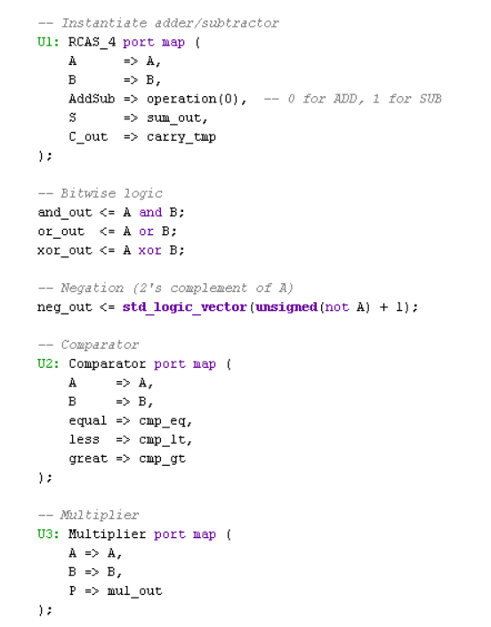
ALU
ALU VHDL CODE

Slide 29
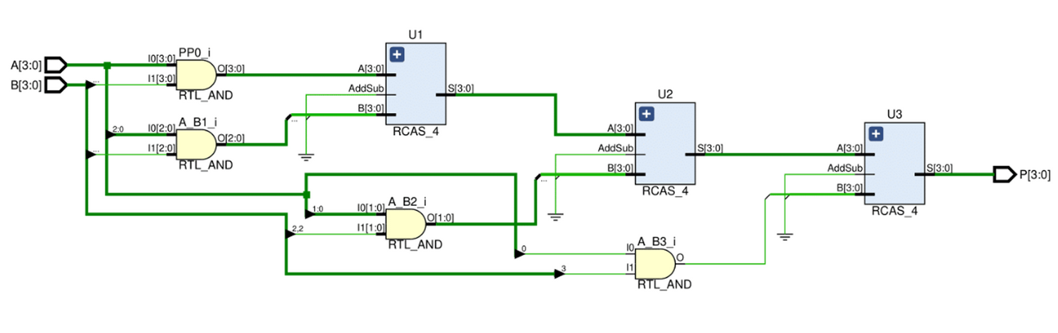
4 BIT MULTIPLIER
Multiplies two 4-bit binary numbers to produce the last 4-bits of the result.
Ripple carry adders are integrated to the component to execute addition within the component to output the correct result.
A sub component of the ALU.

Slide 30
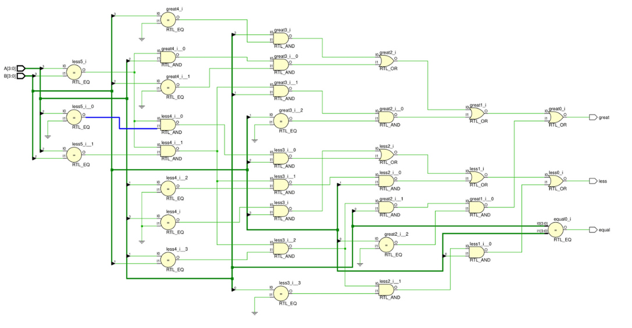
COMPARATOR
Compares the 4 bit inputs to check whether they are greater than, less than or equal to each other.
Checks the 4 bit inputs bitwise, from the MSB towards the LSB.
They contain 3 direct outputs from the nano processor, mapped to 3 LED bulbs of the BASYS 3 FPGA board.
A sub component of the ALU.

Slide 31
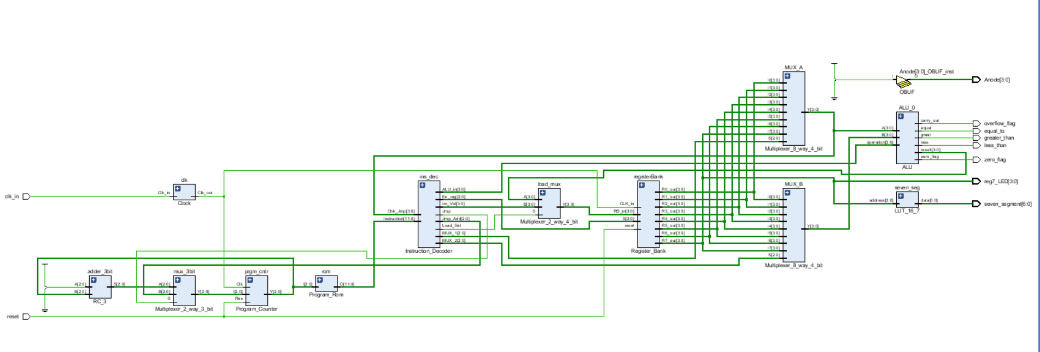
INTEGRATION

Slide 32
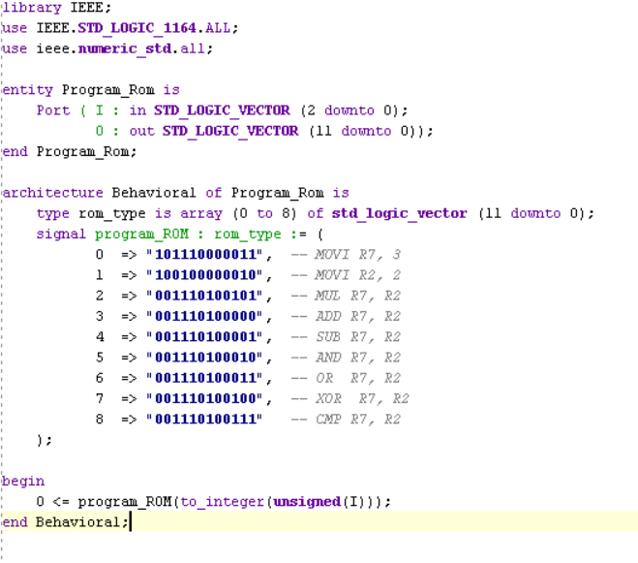
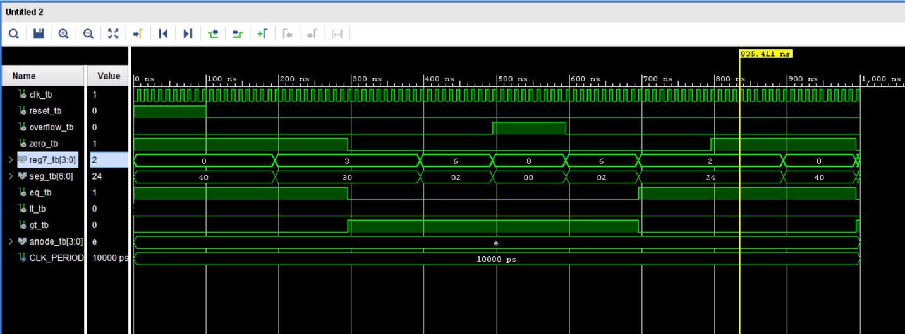
SIMULATION

Slide 33
GROUP MEMBERS
230010L - ABEYSUNDARA K.N.B
230601B - SENEVIRATNE N.S
230361L - H.M.PASINDU LAKMAL
230678N - PANKAJA WAIDYASEKARA

Slide 34
THANK YOU

